Slide 1
Realising Testing Value Through Deployment Pipelines

Slide 2
Y tho?
Building anything is constrained by your ability to deploy safely…

Slide 3
Y tho?
Pipelines facilitate balanced testing, giving a varied view of quality.

Slide 4
Y tho?
Time taken to start testing increases with unreliable deployments

Slide 5
Y tho?
New ways to contribute as testers in a changing world

Slide 6
Be excellent to each other
Code of conduct
Ask questions now, deep dive later.
Help those around you, varied experience in the room.
Technical problems? Flag them and share.

Slide 7
Exercises
Recognising pipeline technology and terminology

Slide 8
Exercises
Building a multi stage pipeline in Jenkins

Slide 9
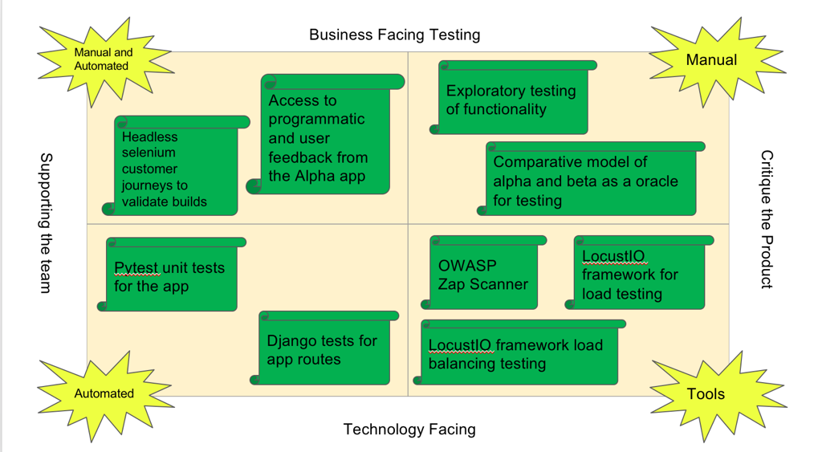
Exercises
Principles of building a pipeline to facilitate balanced testing

Slide 10
Check in
Based on reading the abstract and pre-requisites.
Confidence out of 10, on the scale.
> 8 make yourselves known!

Slide 11
Questions before we start?

Slide 12
Notes:
All of us have encountered a situation where code works on developer system but doesn’t work on testing environment. Docker at a very basic level resolves this issue of working on one platform and not working on another. However there is much more to docker. Docker is present in the entire project workflow but its main use is in deployment.

Slide 13
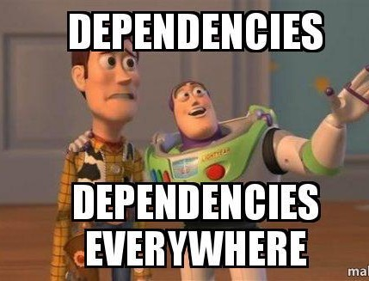
Notes:
Every time you deploy do you get scare?
Do you want to have confidence with each deployment?

Slide 14
Docker can solve pipeline dependencies issues.
Notes:
While you can absolutely use Jenkins without Docker, using Docker provides two big advantages: ease of setup, and replicability. Both of these are due to how Docker uses images and containers.
Same container can run on a Mac, Linux, or modern Windows operating system without modification beyond certain command line options or file system considerations.
What this means for our purposes is that if we have a Docker image for Jenkins we can run a container for Jenkins on any machine that supports Docker with little modification and easily repeat the process across multiple machines.

Slide 15
Docker image has application requirements and dependencies
Notes:
In the doocker image you’ll have application requirements and dependencies.
When you run docker image, you get docker container.
Docker images can also be stored in cloud repository, docker hub, you can also store docker images in your git repo.
These images can be pulled to create container in any environment.

Slide 16
Containers are running instance of docker image
Notes:
Containers allows us to package up an application with all of the parts it needs such as libraries and other dependancies, and docker ship it all out as one package.
With docker you test your application insider a container and ship it inside a container. This means the environment which you test is identical to the one which the app will run in production.

Slide 17

docker info
Notes:
To check if docker is installed properly, run this command
Explain information displayed.

Slide 18
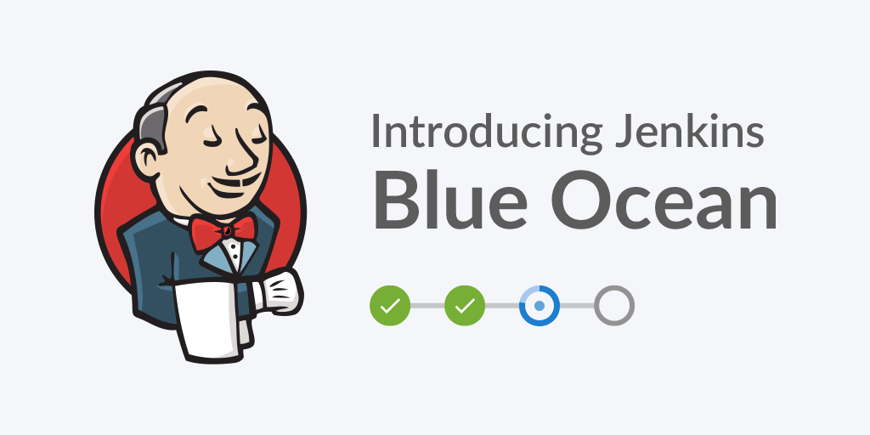
docker pull jenkinsci/blueocean
Notes:
There are different types of Jenkins image available on docker hub.
You can go to docker hub and search for Jenkins images.
jenkinsci/blueocean image is the recommended one for pipelines. Blue Ocean is altogether a more generous attempt to address the user experience issue. Beauty with brains, I must say.
Jenkins Blue Ocean comes with an embedded tool called the Visual Pipeline Editor. This tool allows users to create and edit their pipeline visually using a UI interface that’s accessible directly from the pipeline dashboard. Also, the Visual Pipeline Editor saves your pipeline in code inside a file (Jenkinsfile), following the Declarative Pipeline Syntax, directly to your source code repository.
The pipeline visualization allows users to diagnose pipeline failures with ease and speed. When a pipeline fails, Blue Ocean tells you exactly where it has failed by pointing out the failed step. Also, the pipeline logs are displayed individually for every stage and step of a pipeline, so that users do not end up scrolling through a single huge log.
Blue Ocean also creates separate pages to view your testing results and built artifacts for every pipeline run.
The pipeline creation process in Jenkins Blue Ocean is more like a wizard. It also comes with a UI tool to create and edit pipelines. Above all, it has an interactive pipeline visualization, which makes your pipeline easy to understand.
We’ll explore this in few minutes. Now, lets start Jenkins in docker and create our first pipeline.

Slide 19
Run Jenkins
Notes:
Explain below docker commands -
docker run -u root --rm -d -p 8080:8080 -v jenkins-data:/var/jenkins_home -v /var/run/docker.sock:/var/run/docker.sock --name myjenkins jenkinsci/blueocean
docker run -d -v /var/run/docker.sock:/var/run/docker.sock -p 127.0.0.1:1234:1234 bobrik/socat TCP-LISTEN:1234,fork UNIX-CONNECT:/var/run/docker.sock
docker run --rm -e DOCKER_HOST=docker.for.mac.localhost:1234 docker info
docker exec myjenkins cat /var/jenkins_home/secrets/initialAdminPassword
Now configure the docker url –
Go to http://localhost:8080/configure
Set Docker url to tcp://docker.for.mac.localhost:1234

Slide 20
Declarative Pipeline Syntax
pipeline {
agent any
}
pipeline {
agent any
}
Notes:
My first pipeline – we’ll create a pipeline with Jenkins pipeline configuration.
There are 2 types of pipelines – scripted and declarative pipeline.
Both are basically using same pipeline subsystem. Difference is in syntax and flexibility.
Declarative pipeline limits what is available to the user
Scripted pipeline has same limitations as groovy programming language and is preferred choice for complex projects.
All valid Declarative Pipelines must be enclosed within a pipeline block
Agent - The agent section specifies where the entire Pipeline, or a specific stage, will execute in the Jenkins environment depending on where the agent section is placed. These parameters can be applied at the top-level of the pipeline block, or within each stage directive.
Agent – any, node, label, docker, dockerfile
Stage - Containing a sequence of one or more stage directives, the stages section is where the bulk of the "work" described by a Pipeline will be located. At a minimum it is recommended that stages contain at least one stage directive for each discrete part of the continuous delivery process, such as Build, Test, and Deploy.
When - The when directive allows the Pipeline to determine whether the stage should be executed depending on the given condition. The whendirective must contain at least one condition. If the when directive contains more than one condition, all the child conditions must return true for the stage to execute.

Slide 21

Pipeline - Stages
pipeline {
agent any
stages {
stage(Test') {
steps {
echo 'Hello'
}
}
}
}
Notes:
Stage - Containing a sequence of one or more stage directives, the stages section is where the bulk of the "work" described by a Pipeline will be located. At a minimum it is recommended that stages contain at least one stage directive for each discrete part of the continuous delivery process, such as Build, Test, and Deploy.

Slide 22
Notes:
Let’s build basic pipeline with 3 stages – dev, integration and stage
Echo out some statement

Slide 23
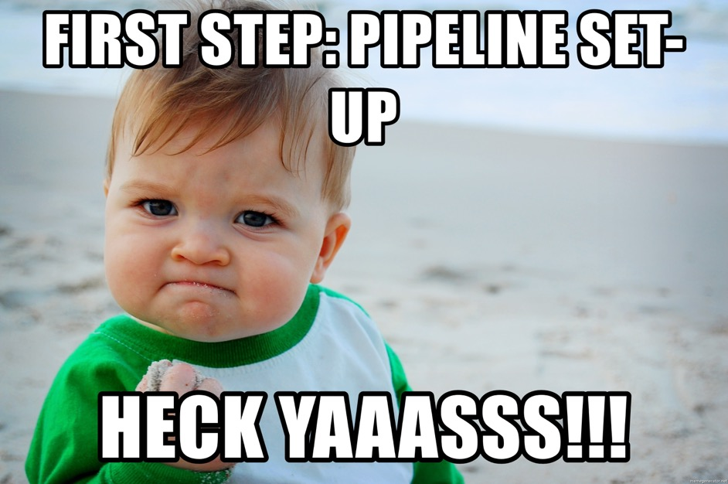

Slide 24
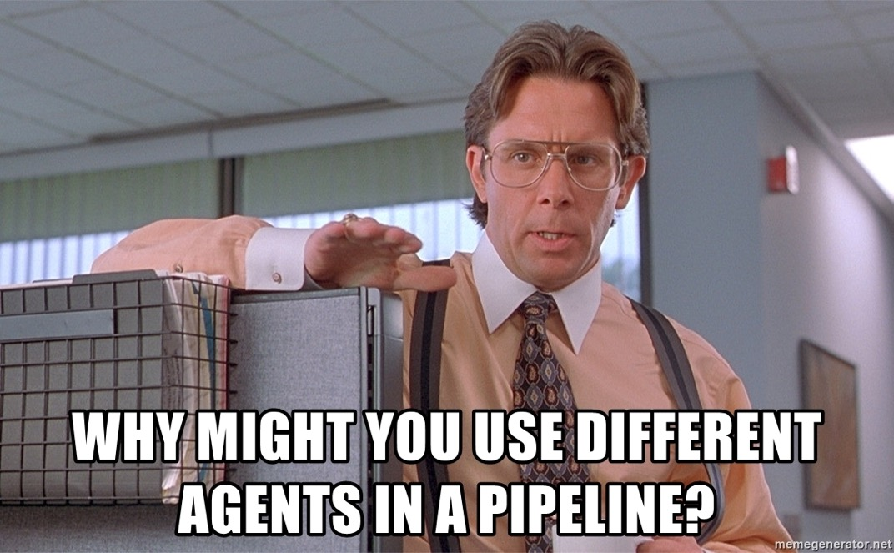

Slide 25
stages {
stage('Parallel Stage’) {
parallel {
stage(‘Front end') {
steps {
echo ”FrontEnd"
}
}
stage(‘Back End') {
steps {
echo ”BackEnd"
}
}
}
}
Notes:
Stage - Containing a sequence of one or more stage directives, the stages section is where the bulk of the "work" described by a Pipeline will be located. At a minimum it is recommended that stages contain at least one stage directive for each discrete part of the continuous delivery process, such as Build, Test, and Deploy.

Slide 26
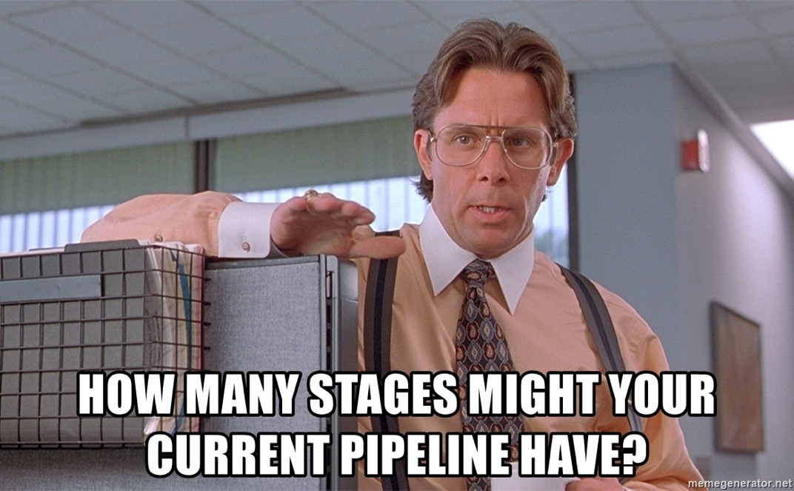

Slide 27
Pipeline - Decisions
stage(Deploy') {
when {
branch 'master’
}
steps {
//Deploy here
}
}
Notes:
When - The when directive allows the Pipeline to determine whether the stage should be executed depending on the given condition. The when directive must contain at least one condition. If the when directive contains more than one condition, all the child conditions must return true for the stage to execute.
Evaluating when before entering agent in a stage
By default, the when condition for a stage will be evaluated after entering the agent for that stage, if one is defined. However, this can be changed by specifying the beforeAgent option within the when block. If beforeAgent is set to true, the when condition will be evaluated first, and the agent will only be entered if the when condition evaluates to true.
Evaluating when before the input directive
By default, the when condition for a stage will be evaluated before the input, if one is defined. However, this can be changed by specifying the beforeInput option within the when block. If beforeInput is set to true, the when condition will be evaluated first, and the input will only be entered if the when condition evaluates to true.

Slide 28
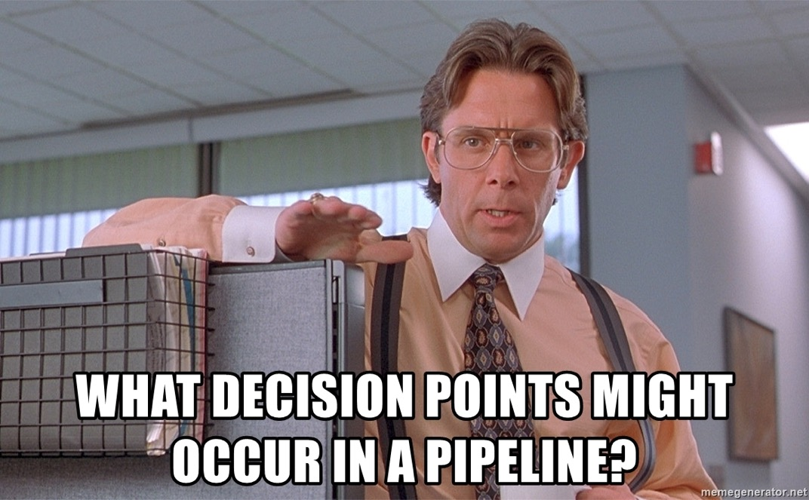

Slide 29
Let’s build advanced pipeline!

Slide 30
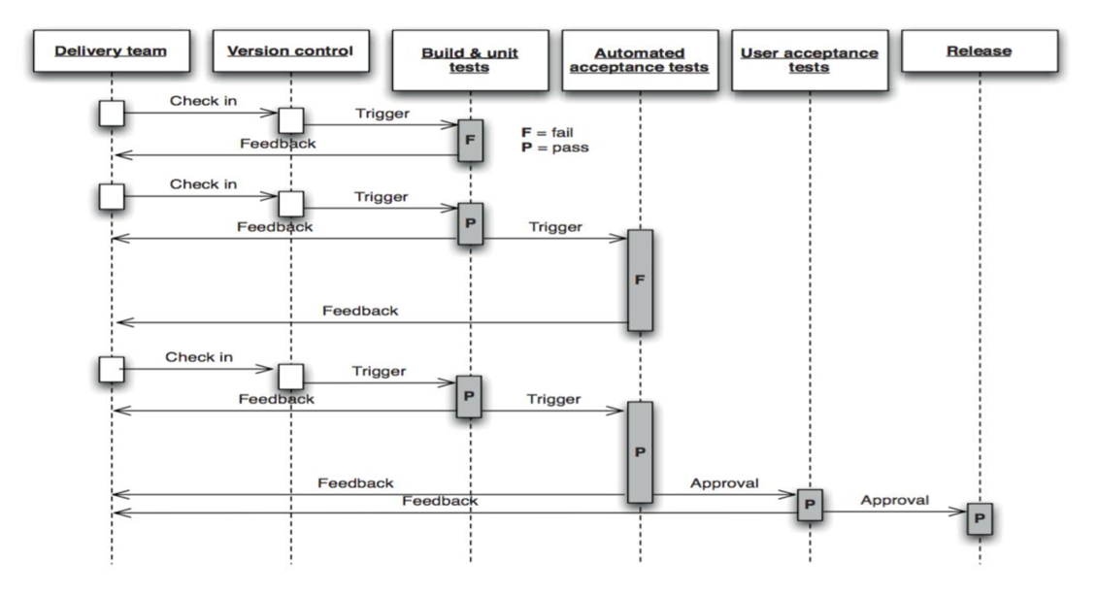

Slide 32

Build pipeline by connecting existing jobs

Slide 33
Pipeline - Input / Pause
Notes:
The input directive on a stage allows you to prompt for input, using the input step. The stage will pause after any options have been applied, and before entering the stage`s `agent or evaluating its when condition. If the input is approved, the stage will then continue. Any parameters provided as part of the input submission will be available in the environment for the rest of the stage.
Why would you add a pause?

Slide 34
stage(‘Exploratory') {
steps {
input('Passed?')
}
}

Slide 36
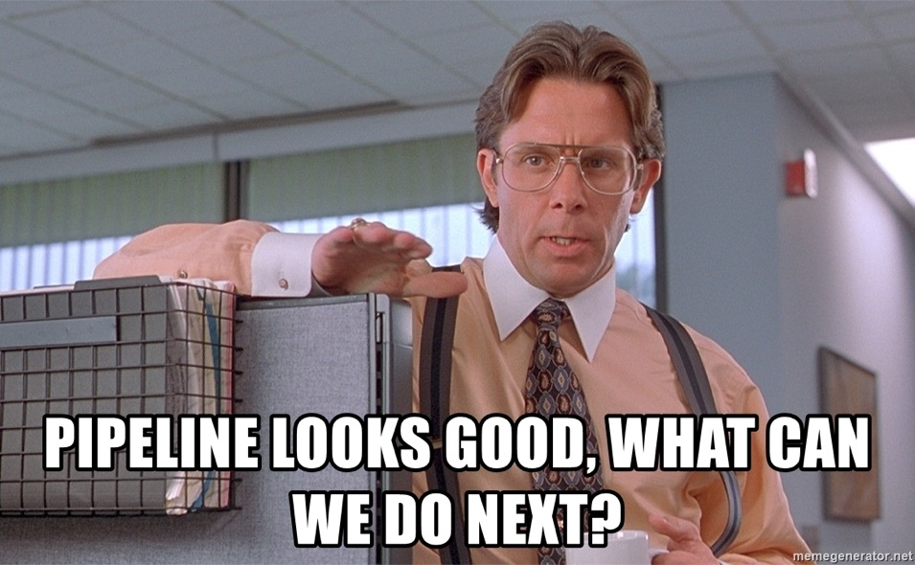

Slide 37

Security pass?

Slide 38
Install OWASP ZAP plugin
Integrate with Jenkins
Create new job
Add ZAP to pipeline job

Slide 39
Using CALMS to design a deployment pipeline

Slide 40
Y tho?
Model to bring to bear on pipeline design and maintenance. And also testing. ☺

Slide 41
CALMS?
Culture
Automation
Lean
Measure
Sharing

Slide 42
CALMS and Pipelines
Build pipelines with principles
Bad pipelines
Upstream
Downstream
They are collaboration points
For humane work

Slide 43
Organise
Groups of 4 or 5
Pipeline owner
Same org is fine
Sit together, lets move around
Big paper, post its, pens

Slide 44
Gather Data
Quiz your pipeline owner on:
Environments
Test strategy
Application context
Risks – real and imagined

Slide 45
Design a Pipeline
Consider:
What makes money
Where risk lies
Most important types of testing
Path to live
CALMS Handout principles
Use the pipeline key to express

Slide 46
Reflections on pipeline design

Slide 47
Final thoughts…

Slide 48

Our journey together…
Building a simple pipeline
Enhancing pipelines with different forms of testing
Design principles for pipelines

Slide 49
Key skills to develop…
Source control
Configuration management
Deployment & release patterns
Understanding architecture

Slide 50
Feedback…

Slide 51
Thank you very much…

